Slide 1
MACK Pages
By: Mohfez Rahman, Ayesha Syeda,
Carri Waller, Keyvan Shabani
Notes:
Talk about who we are (Name, Major) and why we choose IT (personal testimony)

Slide 2
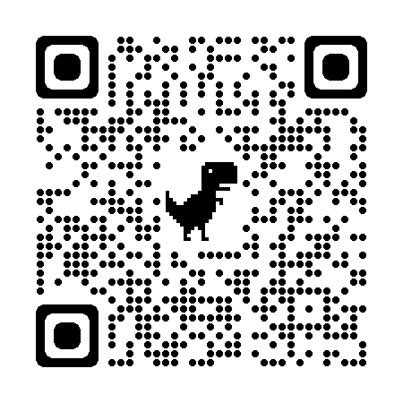
Quick Pre-Survey
https://ggc.az1.qualtrics.com/jfe/form/SV_ba5Xyy10kr2S0NE

Slide 3
What is TAP?
The Technology Ambassador Program (STEC 4800) at GGC allows enrolled students to develop a project that they are completely in control of. They get full power to choose what technology they want to use, and how they want to develop the project. Each project has a goal to teach a new concept to the audience, and bring them a step closer to technology.
Notes:
If you want to join, you have to email the professors offering it. YOU CAN NOT REGISTER ON BANNER WITHOUT PERMISSION.

Slide 4
Goals Of Our Project
Our goal is to educate students about what HTML/API/NFC is
Why is this our goal?
Students nowadays think technology only comes with extreme programming
We aspire to engage students of all ages through our project, and teach simpler ways to tackle their fear of technology
Remember, excellence is not an art. It is the habit of practice!
Aristotle

Slide 5


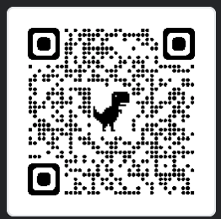
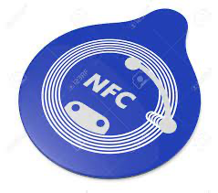

Technologies
HTML: Hypertext Markup Language is the type of programming language that websites are created through.
CSS: Cascading Style Sheets is a formatting add-on to html.
QR Code: An array of black and white squares that stores information and is read by the camera on a smart-device.
NFC: Near-field communication allows communication between two devices over a distance of 4 cm or less.
API: An application programming interface is a software offering a service between computers or between computer programs.

Slide 6
Project Description
Our project is a simple all-about-you page that can be customized with your choices. It is a 5-step diy cover page website that can be obtained with a QR code or NFC chip to share with others. The technologies we are planning to use are Github, QR codes and NFCs. We also have used an API to generate quotes with every page refresh. The target of this project is for users to get introduced to QR code, NFCs, usage of API, and utilize HTML/CSS.
The technologies used in this project are HTML, CSS, QR Code, NFC, and APIs.

Slide 7
Why these technologies?
We are using HTML and CSS to create a personal webpage which will include any information the user want to add. This website will have a section that displays a quote of the day randomly using an API. At the end, we can share this webpage with anyone we want using QR code and NFC.

Slide 8
Workshop Description
Notes:
Show our initial MACK Page

Slide 9
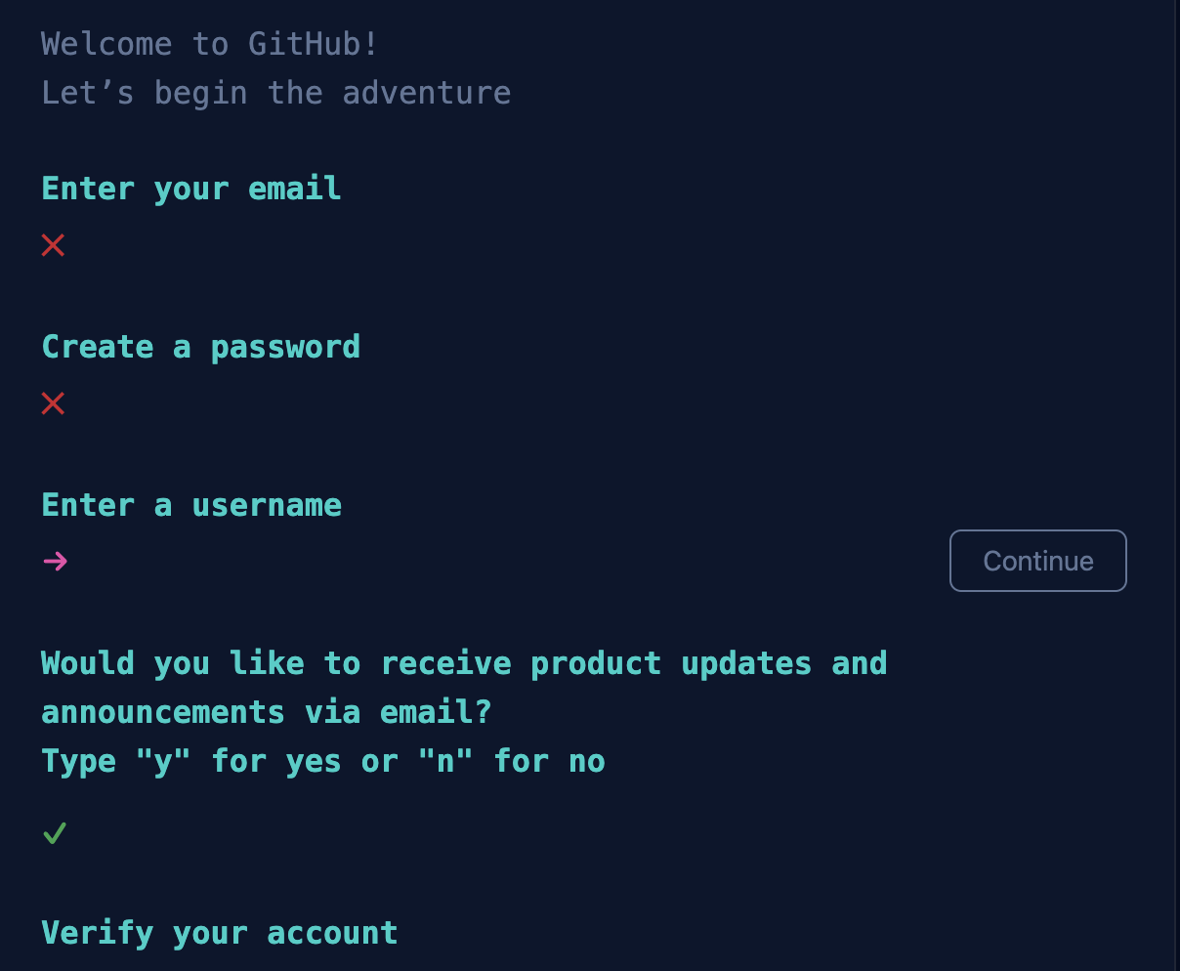
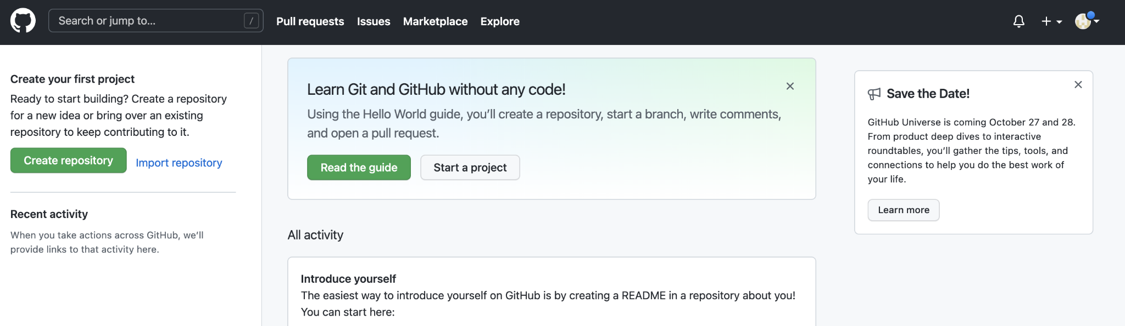
How to access a GitHub Account
Go to this link: Join GitHub · GitHub
Enter your information
Enter the code sent to your email
Select “Just Me”, and select “Student”
Click Continue
Skip Personalization
You’re all set!!! You should see this page

Slide 10
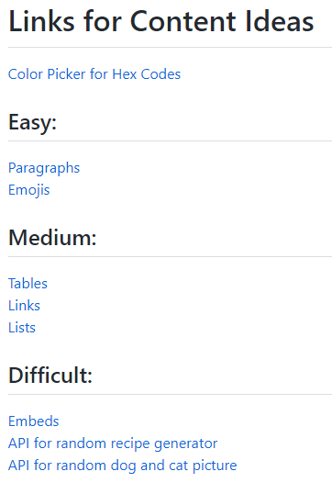
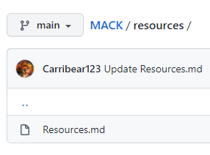
Open Up Resources
Search our project by using this URL, https://github.com/TechAmbassadors-GGC/MACK
Under the ‘Resources’ folder, click on ‘Resources.md’
Open the 1st link (Color Picker) and links for the difficulty level of your choice

Slide 11
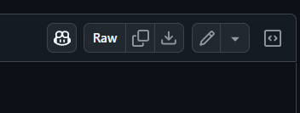
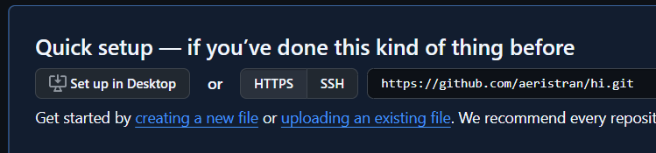
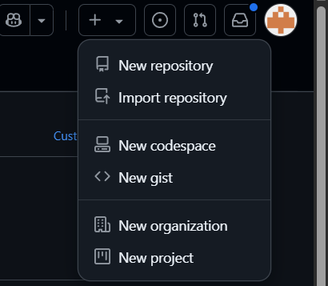
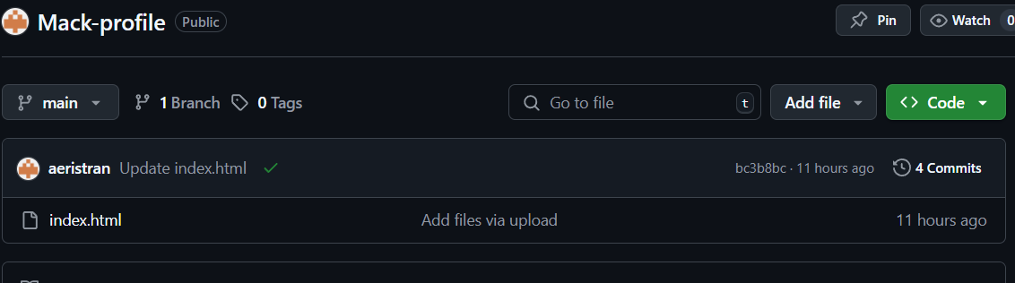
Copy our GitHub Page
Open the ‘code’ folder and click on ‘index.html’
Download the file
Make a new repo and upload ‘index.html’ file
Delete README.md file

Slide 12
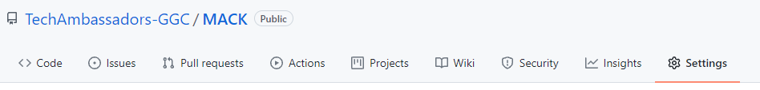
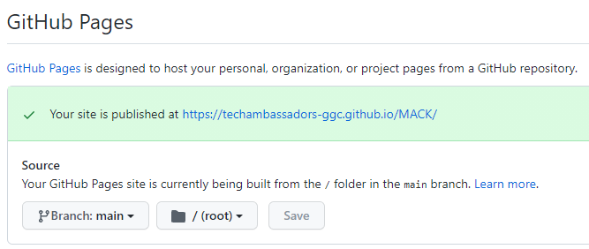
Host Your Website
Go to settings
Under Pages
Branch: main
Folder: /(root)
Hit Save
*Your website link will pop up but you will need to add the folder code (yourlink/code)

Slide 13

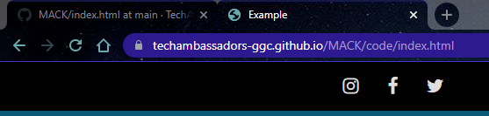
Creating a Title
Going back to our ‘code’ folder and ‘index.html’: on the 4th line, replace the word ‘Example’ with your own title. This will appear in the top part of the tab.

Slide 14
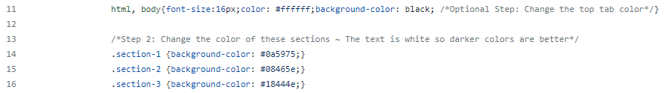
2. Changing the Background Color
On the 11th line, replacing the work ‘black’ with another choice will change the background color. Line 14-16 control the three section colors. Use this link https://www.w3schools.com/colors/colors_picker.asp to pick a new hexadecimal color for each section.
*The text is white so choose darker shades for contrast.

Slide 15
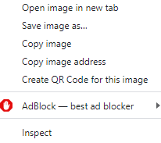
3. Adding a Profile Image
On the 44th line, after src=”, add an image address of your choice.
Delete the https: all the way to .jpg and add your own.
Be sure to have it in this format: src=”image address”

Slide 16
4. Adding a Bio
Add a short biography on line 46. Delete the line Step 4 is on and put your own paragraph. It can be about your favorite color, hobbies, age, school, major, etc. *This is public on your website so don’t put personal phone numbers or home addresses unless you want everyone to see that.

Slide 17

5. Creating Personalized Content
In Github, under ‘resources’ is a Resources.md file where links can help create content for the website.
On line 57 is where you can add all of your content. There is already a paragraph if you want to do it the easy way of typing and using emojis. (*Not including the API’s)

Slide 18
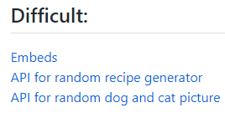
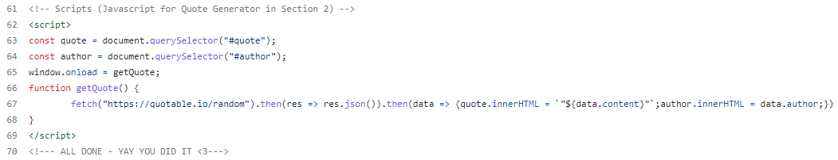
OPTIONAL STEP: Customizing APIs
If you choose the Difficult option, open 1 of the APIs.
Copy the Js file on the far right. This is Javascript and we will be putting it in our ‘script’ area.
You can choose an API and implement it instead of the quote generator on lines 63- 68.

Slide 19
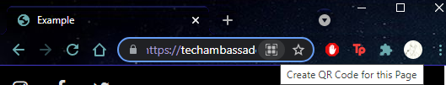
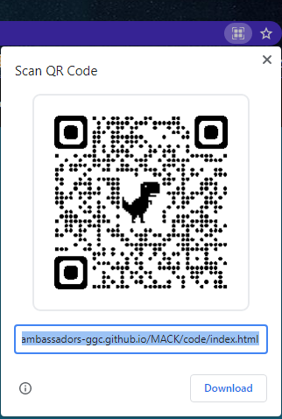
6. Generating QR Code
Click on the search bar, to locate the QR code icon
Scan the QR code with your camera to check if your link is working

Slide 20
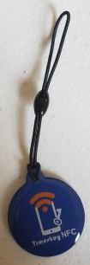
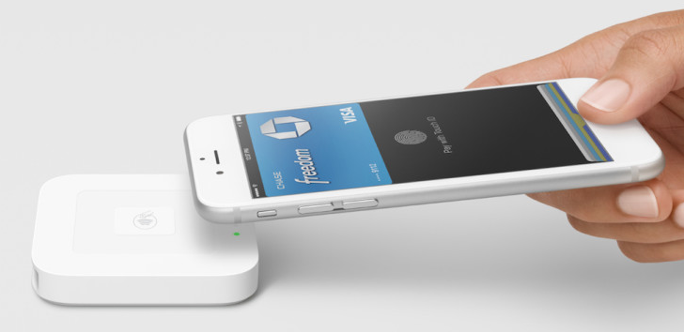
7. Linking to an NFC Chip
After publishing the website with github pages, we will be able to activate a NFC tag using the URL of your website. We will be using a third party NFC app to activate a NFC tag with your URL.
Notes:
How many NFC tags do we have?

Slide 21
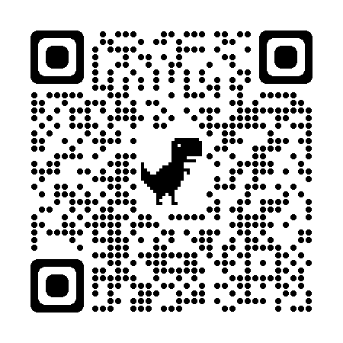
Results
Please fill out the survey!
Leave any feedback you’d like to be implemented!
https://ggc.az1.qualtrics.com/jfe/form/SV_00N4qrtAK9PVoZE

Slide 22
THE END
Thank you!
Questions?

